Slide 1

Preparation before class
preparation before class
Online programming
YahBoom Croco:Kit tutorial

Slide 2
Preparation before class
Content
Part 1
Part 2
Part 3
Part 4
micro:bit introduce
Open programming web
Add YahBoom extension
Downtown
YahBoom Croco:Kit tutorial

Slide 3


Part 1
Preparation before class
What's micro:bit?
Micro:Bit is a microcomputer designed by the BBC for adolescent programming education, which is developed by Microsoft, Samsung, ARM, University of Lancaster, UK and so on.
YahBoom Croco:Kit tutorial

Slide 4
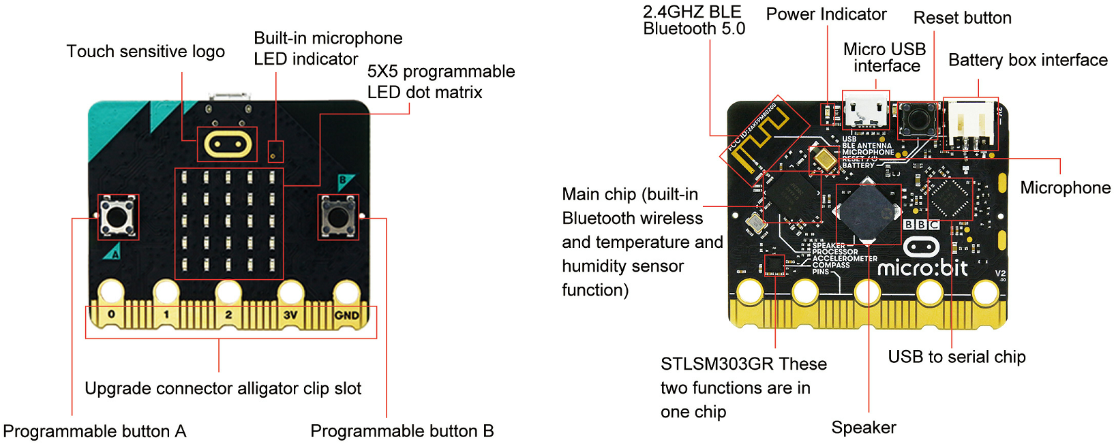
Preparation before class
Part 1
micro:bit
features
YahBoom Croco:Kit tutorial

Slide 5
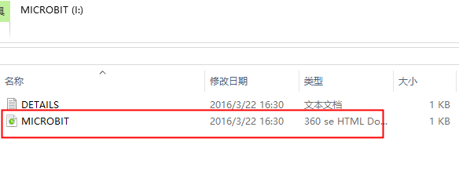
Preparation before class
Part 2
1.First, you use the USB cable to connect the micro:bit to the computer, at this point, the computer will have a micro:bit U disk. Open it, click micro:bit website, then entered the micro:bit website
How to open a programming web page?
YahBoom Croco:Kit tutorial

Slide 6
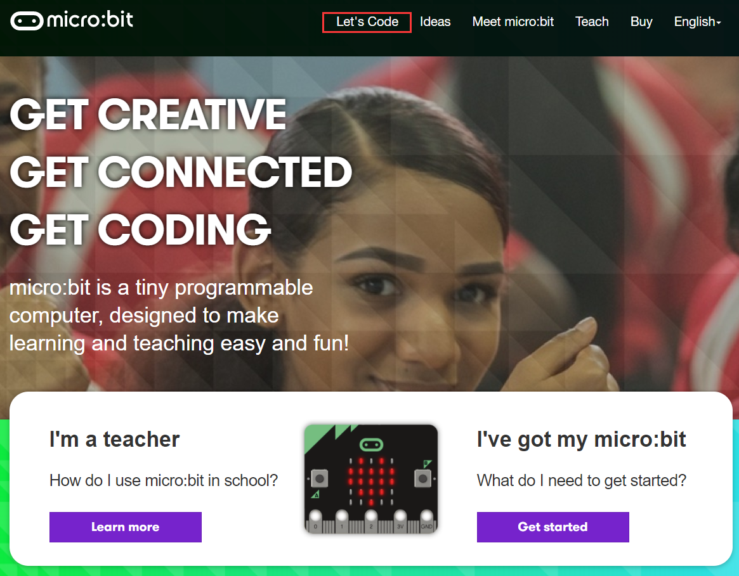
Preparation before class
Part 2
2.After entering the micro:bit, click Let's Code
How to open a programming web page?
YahBoom Croco:Kit tutorial

Slide 7
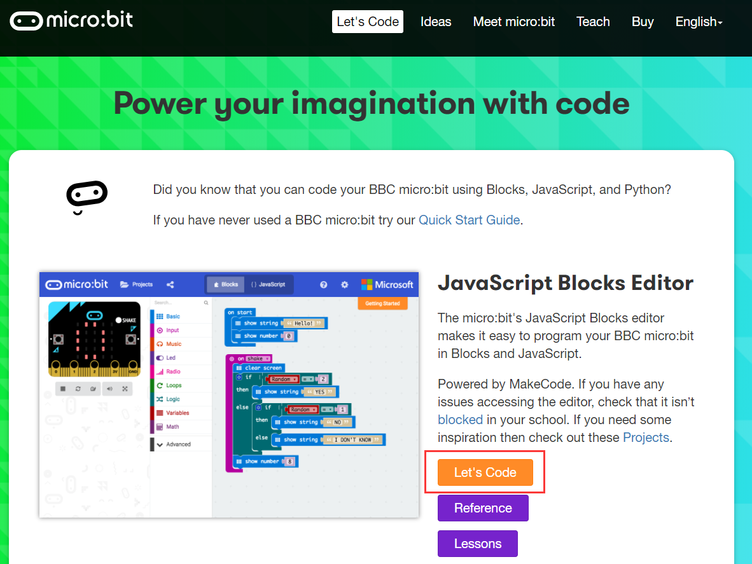
Preparation before class
Part 2
When you get into a new page, click on the screen below [Let's Code],
You can get into the programming page.
How to open a programming web page?
YahBoom Croco:Kit tutorial

Slide 8
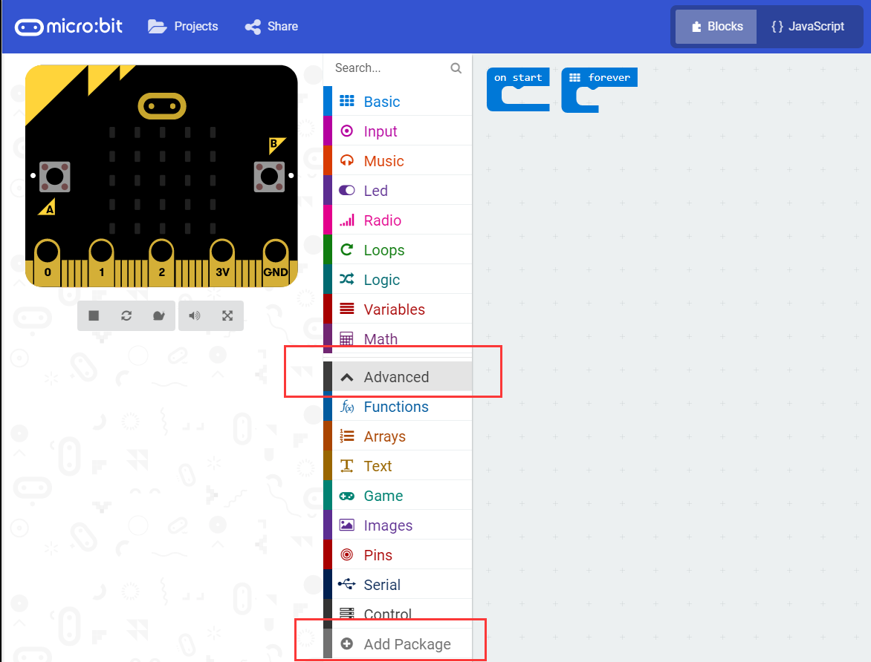
Preparation before class
Part 3
Click Advanced, then Click Add Package
How to add YahBoom extension
YahBoom Croco:Kit tutorial

Slide 9
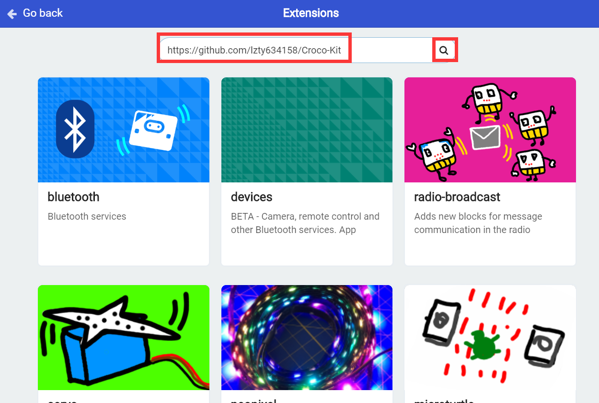
Preparation before class
Part 3
Enter the URL in the input column:https://github.com/lzty634158/Croco-Kit.
Then,we need to search or press “Enter” key on the keyboard.
How to add YahBoom extension
YahBoom Croco:Kit tutorial

Slide 10
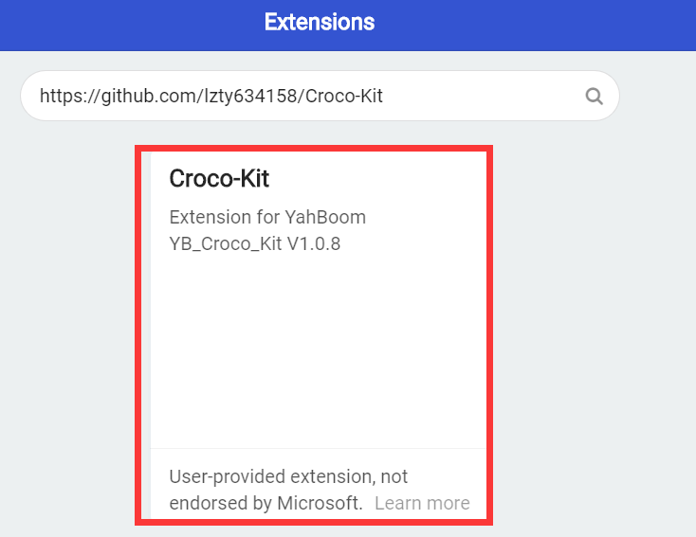
Preparation before class
Part 3
Click ”Croco-kit”, and you can add the package successfully.
How to add YahBoom extension
YahBoom Croco:Kit tutorial

Slide 11
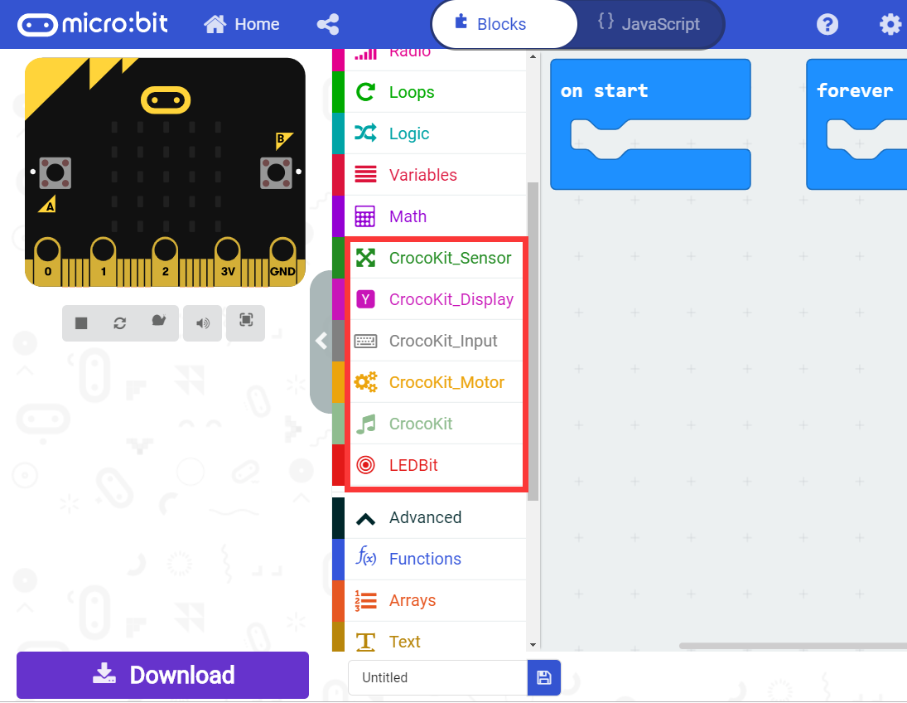
Preparation before class
Part 3
After loading the package, we can see that the program bar has loaded the blocks made by YahBoom.
How to add YahBoom extension
YahBoom Croco:Kit tutorial

Slide 12
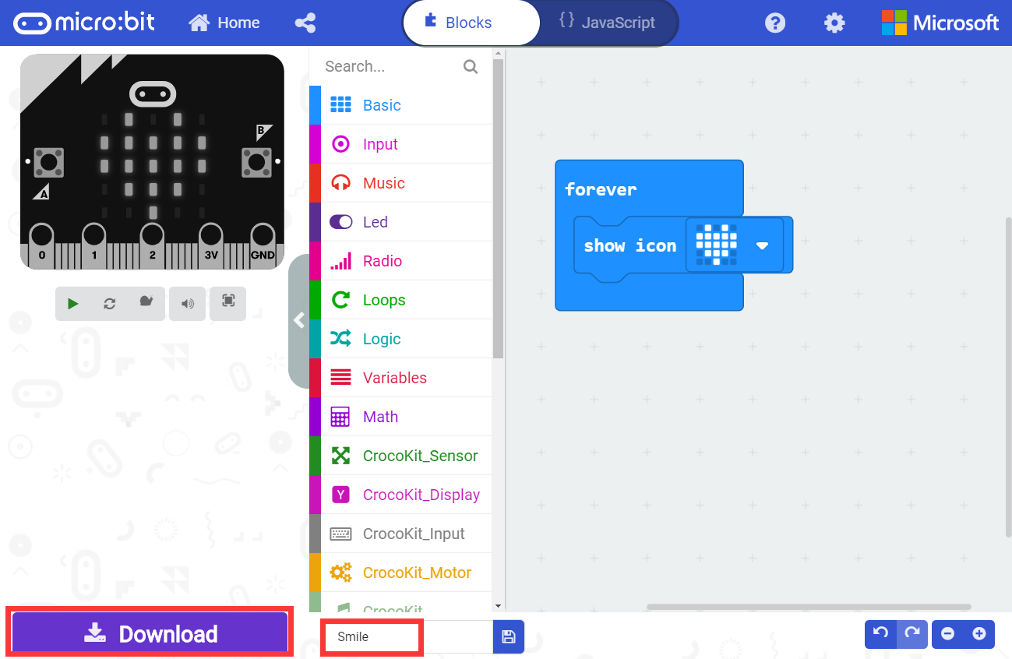
Preparation before class
Part 4
After the building blocks, click Download. You can set the download path in the U disk of micro:bit, download it to the computer, and then copy it or send it to the U disk in micro:bit.
How to download
micro:bit code?
YahBoom Croco:Kit tutorial

Slide 13
Preparation before class
micro:bit
project
Thank you ！
Powered by YahBoom
YahBoom Croco:Kit tutorial

